Slide 1

Cross Platform Mobile and Web Apps Development
Day 2

Slide 2
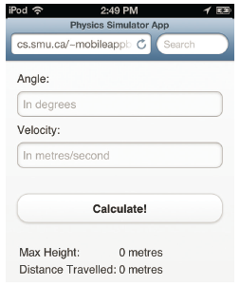
Projectile App Calculations
Create the projectile app calculations in a separate JavaScript file.
The <body> tag should have an attribute called “onload”, which calls the JavaScript function “initialize()”
The button in the form is called “Calculate!” and triggers a JavaScript function “update()”

Slide 3
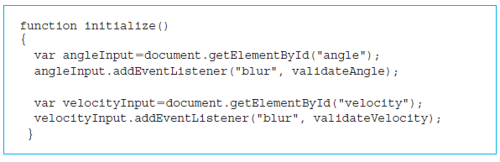
Projectile App Input Validation
Error checking in the Projectile app by the JavaScript function “initialize()”.

Slide 4
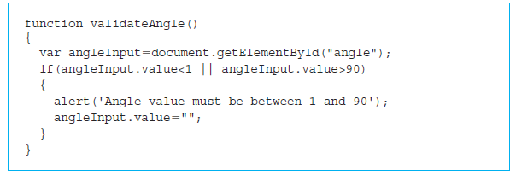
Projectile App Input Validation
JavaScript function validateAngle() is called when the user has entered the value of the angle.
angleInput.value < 1
angleInput.value > 90

Slide 5
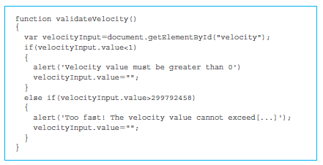
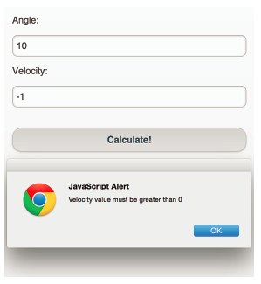
Validating Angle and Velocity
JavaScript function validateVelocity() ensures that the velocity is greater than 0 and less than 299,792,458 (speed of light).

Slide 6
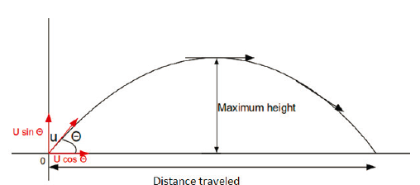
Calculation of projectile distance and height

Slide 7
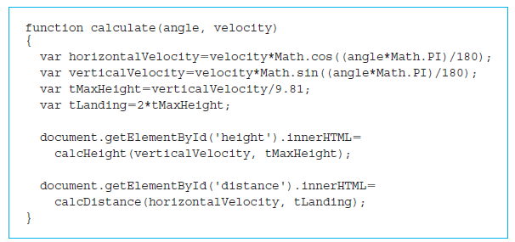
JavaScript Calculations

Slide 8
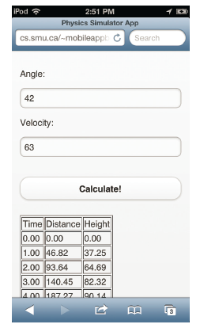
Exercise
Finish the Projectile App implementation using jQuery Mobile.
Enhance the projectile tracking app by adding a time interval variable and displaying distance and height over each interval, as shown in the screenshot.
Upload the code to the server and test using mobile and desktop browsers.

Slide 9
Temerature Converter App Design
The objective: to allow users to convert temperature from Fahrenheit to Celsius, and vice versa.
Simple and intuitive
App is on one screen
Users of our app will be able to input a temperature in one scale, either Celsius or Fahrenheit, and convert it to the other scale.

Slide 10
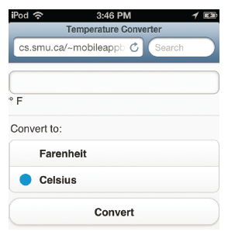
Graphic Design
Create a single screen that accepts the temperature and a radio button that tells us whether the temperature is in Fahrenheit or Celsius.

Slide 11
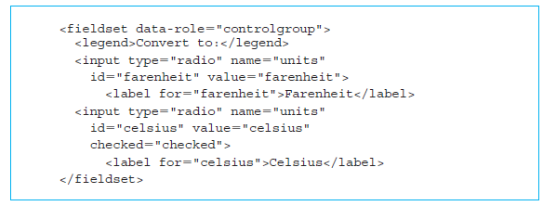
HTML5 Code

Slide 12
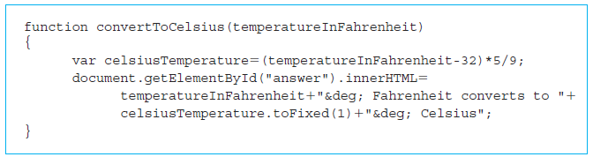
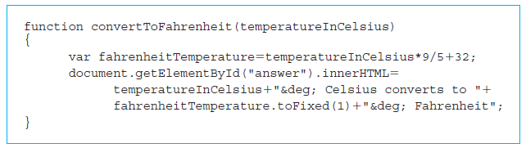
JavaScript Calculations

Slide 13
Exercise
Implement the Temperature Converter App using jQuery Mobile.
Upload the code to the server and test using mobile and desktop browsers.

Slide 14
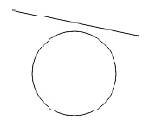
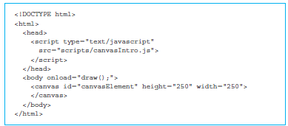
HTML5 Graphics
The body contains the canvas element where we will be drawing a line and a circle.

Slide 15
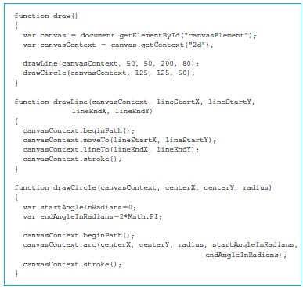
Canvas Drawing
Retrieve the canvas using the getElementByID() method, employing the “canvasElement” as the id.
drawLine() function
drawCircle() function

Slide 16
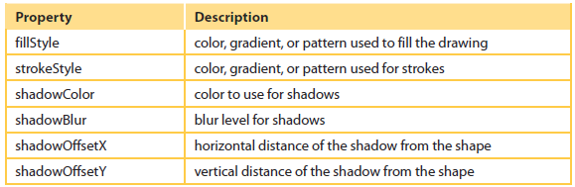
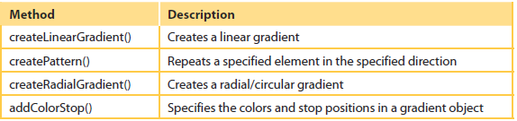
Canvas Element’s methods and properties
Learn more at www.w3.schools.com

Slide 17
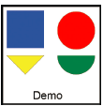
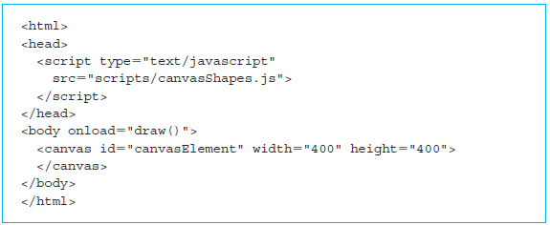
Canvas Shape HTML

Slide 18
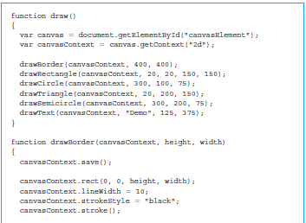
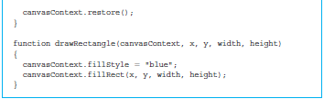
Canvas Shape JavaScript
Retrieve the canvas using the getElementByID() method employing the “canvasElement” as the id.
The drawBorder() function receives three parameters: the canvas context element and the height and width of the canvas.
Other shapes can be rendered on canvas using similar approach.

Slide 19
Exercise
Enhance the Projectile App implementation using HTML5 Graphics.
Upload the code to the server and test using mobile and desktop browsers.
Present your solution to the class: describe what difficulties you encountered and how you overcome them.

Slide 20
Homework
Download the RGraph JavaScript library from http://www.rgraph.net
Review the examples and documentation on the RGraph web site.
Enhance the Projectile app by replacing HTML5 graphics with an RGraph graph.

